Slide 1
Showing Apps
Can You Get Paid to Show Properties for Others?
Notes:
This Sales Meeting Kit will discuss the issues with using showing apps that create “pay for showing” arrangements between agents from different firms.

Slide 2

What is a Showing App?
An app that connects you with another agent to show properties to your buyers for a fee.
There are several legal and regulatory issues to consider before using these apps with agents from other firms.
Notes:
[Read slide]
Let’s dive into some of the risks of using these types of apps.

Slide 3
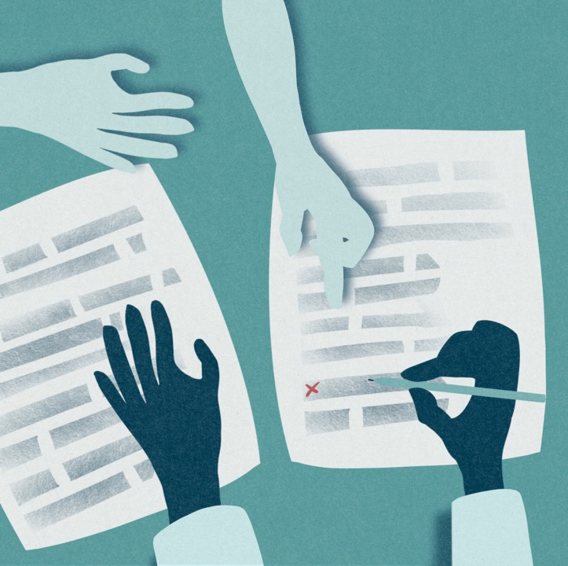
No Buyer Representation Agreement
Under Virginia law and as a REALTOR®, you are required to have a buyer representation agreement before showing property to a buyer, unless you are working on behalf of the seller.
Notes:
[Read slide]
In Virginia, a buyer’s agent must have a buyer representation agreement with a buyer before showing property.
Citation: VA Code § 54.1-2137.A.1
Risk scenario: If an app connects you to another firm’s buyer, you likely have no representation agreement with that buyer.

Slide 4

Performing Services Outside Your Firm
Showing a buyer property who has an exclusive buyer representation agreement with another firm without an agreement of your own may be treated as performing real estate services for another firm.
Notes:
[Read slide]
Potential conflict of interest: 18VAC135-20-270.1
Potential prohibited act: 18VAC135-20-260.11.g
Bottom line: Most likely not allowed under the typical app-referral arrangement.

Slide 5

Payment Without Broker Authorization
New regulations allow compensation from other sources only with written permission from your broker.
Notes:
New regulations allow compensation from other sources only with written permission from your broker.
Citation: 18VAC135-20-280.A.2
Even if broker permission is obtained, you still must address:
Representation agreement requirement
Whether you are performing regulated activities outside your firm

Slide 6

Possible Compliant Arrangement
Exclusive buyer brokerage agreement includes a carve-out for “showing-only” services.
Agreement explicitly allows buyer to sign separate showing agreements with other firms.
Buyer signs a limited showing agreement with the showing agent (from the app) that aligns with the carve-out and discloses compensation.
Showing agent obtains required broker approvals for any outside compensation.
Notes:
[Read slide]
The initial buyer representation agreement would need to include
1. Clear description of the arrangement
2. Disclosure that outside agents may show property
3. How those outside agents will be compensated
The showing agent’s agreement would need to:
Comply with the scope of the carve-out of the initial buyer representation agreement
Disclose how much compensation and from whom the showing agent is compensated.
The showing agent’s broker must approve this type of agreement.

Slide 7

Takeaways
You generally cannot show property without a representation agreement.
App-based “show for pay” setups can create outside-the-firm and prohibited act concerns.
Compensation may be possible with written broker permission, but that alone does not solve agency/representation issues.
If pursued, it likely requires careful contract language, disclosures, and a limited showing agreement.
Notes:
[Read slide]

Slide 8

Questions and Resources
If you have questions about these types of apps or similar arrangements, Virginia REALTORS® provides resources, including the Legal Hotline.
https://virginiarealtors.org/law-ethics/legal-resource-library/
https://virginiarealtors.org/law-ethics/legal-hotline/
Notes:
If you have any questions about these types of apps or similar arrangements, please utilize these resources.

