Slide 1
How to use the home inspection contingency addendum & removal forms
VAR Forms 600D & 600E
Notes:
This presentation will cover the proper use of VAR Forms for a Home Inspection Contingency and Removal. (VAR Forms 600D and 600E)

Slide 2

What Is A Home Inspection Contingency?
A Home Inspection Contingency is an agreed time period in a residential real estate purchase contract wherein the purchaser may conduct inspections of the home. If the results of the inspections are not satisfactory to the purchaser, then the purchaser may cancel the contract. Additionally, if the inspections are not satisfactory, the parties may negotiate repairs or a price adjustment so that the purchaser will release the contingency and proceed with the transaction.
Notes:
[Read Slide]

Slide 3
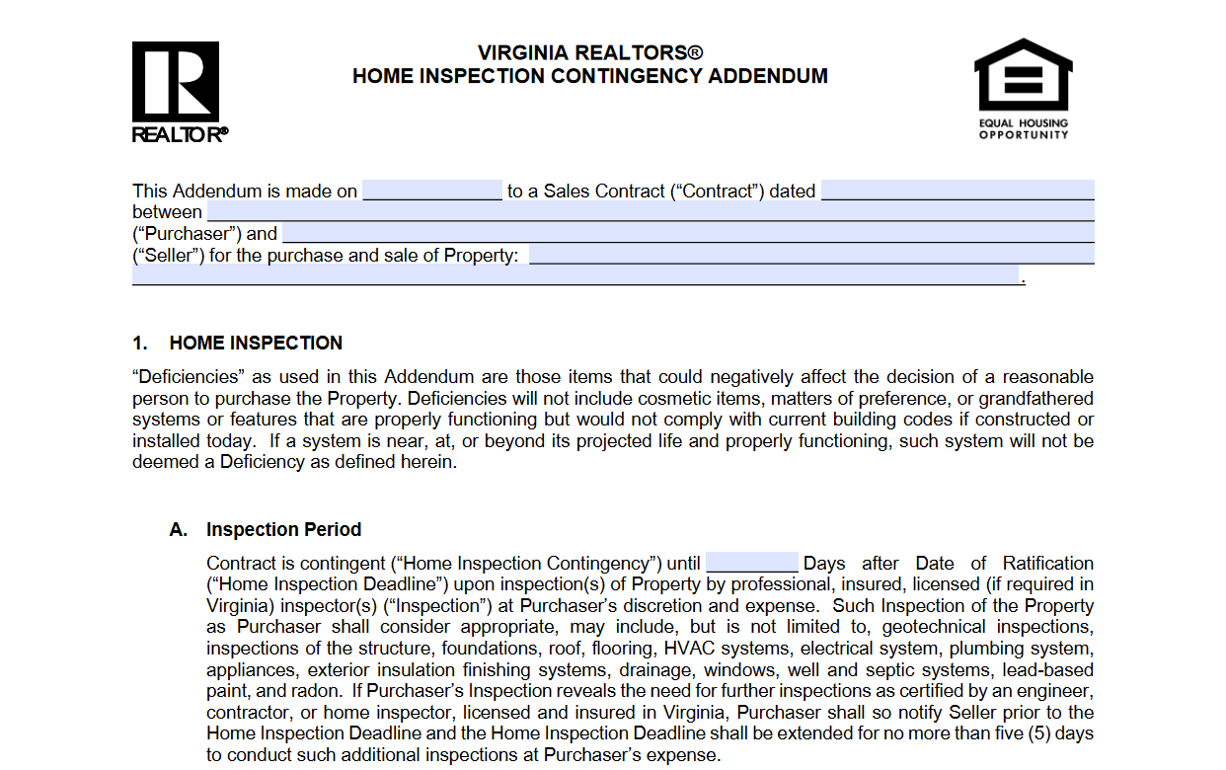
Home Inspection Contingency Addendum
Use VAR Form 600D to create a Home Inspection Contingency.
Use the blank in Paragraph 1A to determine the length of the Home Inspection Period. The Home Inspection Period begins upon Contract Ratification.
Note: Inspections must be performed by professional, insured, and licensed home inspectors. If need for additional specialized inspections arises, then contingency period shall be extended up to 5 days.
Notes:
To create a home inspection contingency, use VAR Form 600D. You will first want to decide on the number of days from ratification for purchaser to conduct a home inspection(s).
If purchaser wants more time to conduct additional inspections, the purchaser must notify seller prior to the Home Inspection Deadline to receive no more than 5 additional days.

Slide 4
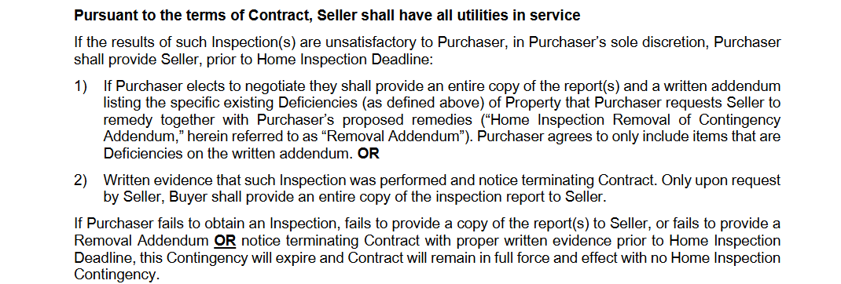
Purchaser’s Options Following Inspections
If inspections are unsatisfactory to purchaser, purchaser may elect to negotiate or terminate the contract.
If purchaser elects to negotiate, then purchaser is required to provide seller with a copy of the inspection report(s).
If purchaser elects to terminate the contract, purchaser is required to provide seller with inspection report(s) only if requested by seller.
VAR Form 600D
Notes:
[Read Slide]

Slide 5
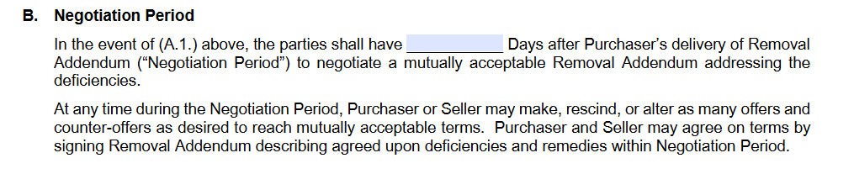
The Negotiation Period
Use Paragraph B. to set the Negotiation Period.
The Negotiation Period is after the inspection period and provides the parties time to negotiate removal of the home inspection contingency.
The Negotiation Period begins upon purchaser delivering the Home Inspection Contingency Removal Addendum.
VAR Form 600D
Notes:
[Read Slide]
Once the purchaser delivers to seller a Home Inspection Contingency Removal Addendum (VAR Form 600E), the Negotiation Period begins. We will see this form on the next slide.

Slide 6
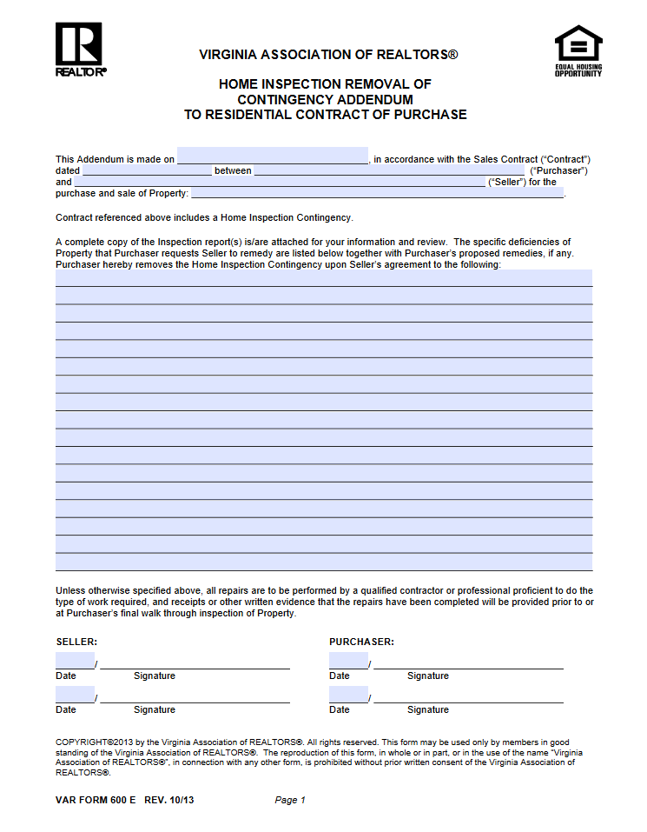
Removal of Contingency Addendum
Use VAR Form 600E for list of deficiencies that will be corrected to remove contingency.
The parties may make as many offers and counteroffers during the Negotiation Period as needed.
Notes:
[Read Slide]
It may take several back and forth offers and counteroffers during this Negotiation Period to come to an agreement. If the parties agree on a removal addendum, then the contingency is removed.

Slide 7
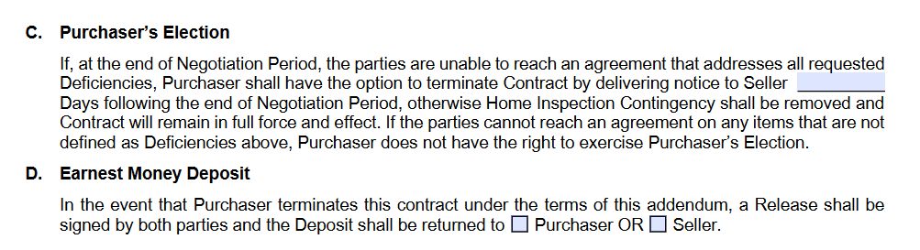
Purchaser’s Election to Cancel Contract
Use Blank to set number of days after end of Negotiation Period for Purchaser’s Election to cancel contract.
If during the Negotiation Period, the parties are unable to agree on terms to remove the Home Inspection Contingency, then purchaser may cancel contract with written notice to seller.
VAR Form 600D
Notes:
[Read Slide]
If the parties cannot agree on a removal addendum, then the purchaser has a set time to decide whether to terminate the contract. After the Negotiation Period ends, the purchaser will have “x” number of days (depending on what is written in the blank) to exercise the Purchaser’s Election to cancel the contract.
If the purchaser fails to notify seller of the election within this time period, the contingency is automatically removed.

