Slide 1
Creating Member-Focused Content
Robin Spensieri
Vice President of Communications & Media Relations
Virginia REALTORS®

Slide 2
RDR

Slide 3
REALTORS® Don’t Read!

Slide 4
RAB

Slide 5
REALTORS® Are Busy!

Slide 6
How Do We Get Our Members to Engage with Our Content?

Slide 7
1. Focus on what’s in it for THEM.

Slide 8
Why should I open this email? Why should I click on this link? Why should I attend your event/class? Why should I care? What’s in it for me?

Slide 9
Make the Most of Your Subject Line

Slide 10
Subject Lines 1. What’s in here? 2. How will I benefit from reading this email? 3. Be specific.

Slide 11
Subject Lines I Clicked On

Slide 12
Amplify Your Subject Line with a Preheader

Slide 13
Subject Line
Subject Line
Preheader

Slide 14
Subject + Preheader = What’s in it for them (specifically!)

Slide 15
NO: Upcoming Education Opportunity – Next week, our association is hosting a CE class for…

Slide 16
YES: CE Credit AND a Free Lunch?! – Only a few spots left for Tuesday’s New Laws course.

Slide 17
NO: Real Estate & Taxes: What Agents Need to Know – Tuesday, August 2, 2023

Slide 18
YES: Our MOST Requested CE Course is Back! – 3 days left to register for Real Estate & Taxes: What Agents Need to Know

Slide 19
Real-Life Example e-news: Disclosing Prior Appraisal Values, Legal Case Study: Omissions in Contracts – YOUR Chance to Ask Our Economists Questions
*June 16th e-news:
Nearly 50% Open Rate

Slide 20
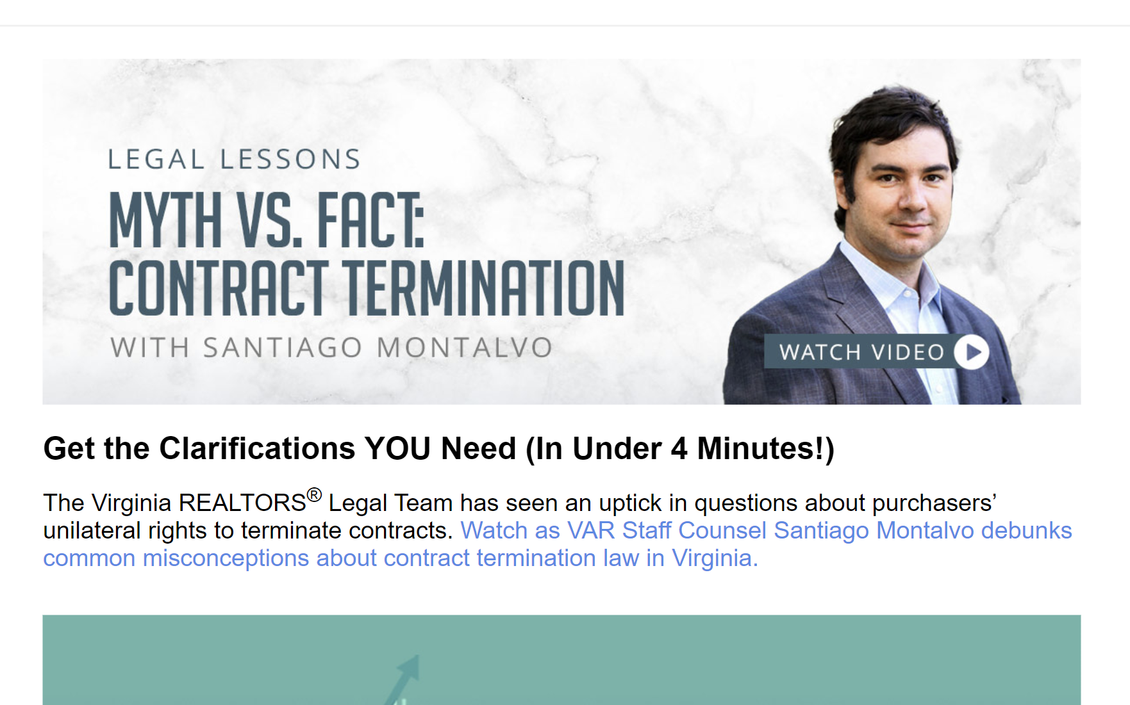
Once they’ve opened it…

Slide 21
Once they’ve opened it…

Slide 22
2. Highlight Benefits Instead of Features

Slide 23
Features vs. Benefits OK) Here's what we do for you/offer you (member) BETTER) Here's what you (member) can do because of what we offer you

Slide 24
Features vs. Benefits DECENT) Register today for our 2023 annual convention with A-list keynote speakers Daymond John and Shannon Miller.

Slide 25
Features vs. Benefits BETTER) Earn CE, network with top-selling REALTORS®, and learn strategies for boosting your business ALL by attending Amplify 2023. Did we mention Shark Tank star Daymond John will be there?

Slide 26
Features vs. Benefits DECENT) Register today for our 2023 New Laws class

Slide 27
Features vs. Benefits BETTER) Ensure YOUR Team is prepared to follow the new laws coming July 1st

Slide 28
3. Use Your Members to Help Engage Your Members.

Slide 29
Members Are a Resource

Slide 30
Members Are a Resource

Slide 31
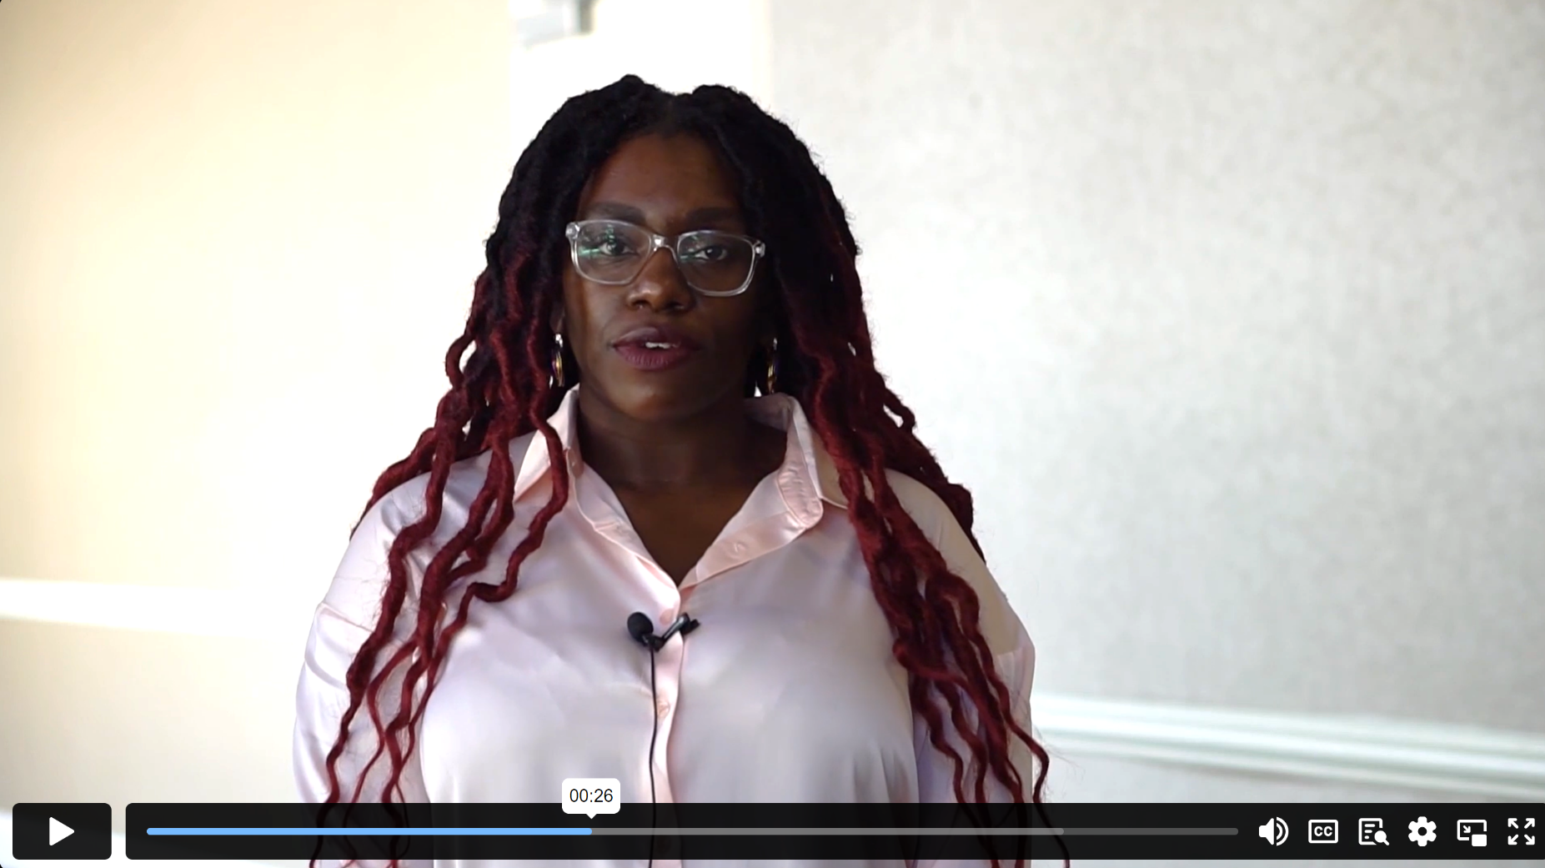
Why Should Members Attend Our Convention?
Your Network
is
Your Net WORTH

Slide 32
Creating Member-Focused Content: -What’s in it for THEM? -Benefits Over Features -Utilize Your Membership as a Resource

