Slide 1
Fair Housing: SOURCE OF FUNDS GUIDANCE
Notes:
Instructor: This toolkit will review the guidance document DPOR and the Fair Housing Office provided in April 2021 for the source of funds protected class.

Slide 2
Unlawful Discrimination
“It shall be an unlawful discriminatory housing practice for any person to . . .
Refuse to sell or rent after the making of a bona fide offer, or to refuse to negotiate for the sale or rental of, or otherwise make unavailable or deny, a dwelling to any person;
Discriminate against any person in the terms, conditions, or privileges of sale or rental, or provision of services or facilities in connection therewith;
Make, print, or publish . . . Any notice, statement, or advertisement, with respect to the sale or rental of a dwelling that indicates any preference, limitation, or discrimination . . . Or intention to make any such preference; [and]
Represent to any person . . . That any dwelling is not available for inspection, sale, or rental when such dwelling is in fact so available,
"Source of funds" means any source that lawfully provides funds to or on behalf of a renter or buyer of housing, including any assistance, benefit, or subsidy program, whether such program is administered by a governmental or nongovernmental entity.
Notes:
Instructor: Fair Housing law makes it unlawful to discriminate in these ways based on certain protected classes, which since 2020 includes a person’s source of funds. This list is not inclusive, but includes the four primary categories of discriminatory conduct.
Source: Virginia Code § 36-96.1:1, 36-96.3

Slide 3
Important Exemptions
I. Nothing in this chapter shall prohibit an owner or an owner's managing agent from denying or limiting the rental or occupancy of a rental dwelling unit to a person because of such person's source of funds, provided that such owner does not own more than four rental dwelling units in the Commonwealth at the time of the alleged discriminatory housing practice. However, if an owner, whether individually or through a business entity, owns more than a 10 percent interest in more than four rental dwelling units in the Commonwealth at the time of the alleged discriminatory housing practice, the exemption provided in this subsection shall not apply.
J. It shall not be unlawful under this chapter for an owner or an owner's managing agent to deny or limit a person's rental or occupancy of a rental dwelling unit based on the person's source of funds for that unit if such source is not approved within 15 days of the person's submission of the request for tenancy approval.
Notes:
Instructor: Importantly, a person’s source of funds may be considered without it being considered discriminatory in these two circumstances. First, if the owner of the property owns four or less properties (ownership defined as greater than 10% interest in a property) they may consider a person’s source of funds. That includes if they have an agent managing the property – regardless of how many properties the agent manages. Second, if an owner approves a tenant subject to their source of funds approving the property under a certain program, and the approval takes longer than 15 days after the owner requests tenancy approval, the owner may deny the rental on that basis.
Source: Virginia Code § 36-96.2

Slide 4
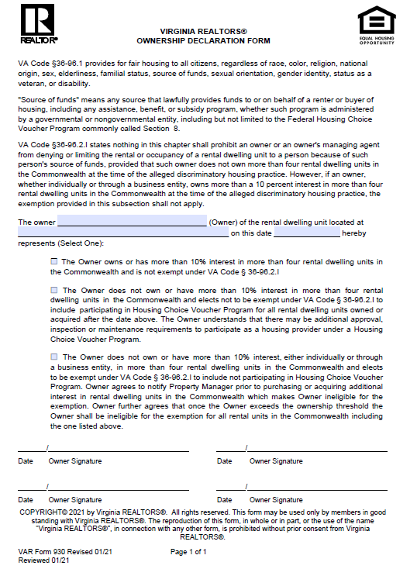
Virginia REALTORS Ownership Declaration Form – Form 930
Notes:
Instructor: Virginia REALTORS has a form you can use to verify how many properties your client owns to determine whether or not the “4 or less properties” exemption applies. We recommend that you have your clients review this and complete it, and verify or update it regularly.

Slide 5
Application to Sales
“The policy of the Commonwealth is to prohibit discriminatory practices with respect to residential housing on the basis of source of funds—not to prevent non-discriminatory consideration of financing during housing transactions.
Sellers may consider financial terms and conditions from prospective purchasers.”
Notes:
Instructor: The implementation of the source of funds protected class has still led to questions from real estate licensees, which DPOR and the Fair Housing Office have answered within a Guidance Document provided in April 2021. You can find the Guidance Document on DPOR’s website, and we encourage you to read it in full, particularly if you manage properties. But let’s start with sales and whether the source of funds protected class applies here and how. The Guidance Document says explicitly that sellers may consider financial terms and conditions from prospective purchasers without running afoul of the law. Specifically, sellers may consider the loan program or type of loan, including VA and FHA loan terms, as compared to all cash offers or conventional loans.
Source: Guidance Document, pp. 2-3

Slide 6
Verifying Income & Duration
“The prohibition against source-of-funds discrimination does not prohibit a housing provider from determining the ability of any potential buyer or renter to pay a purchase price or pay rent by verifying—in a commercially reasonable manner—the source and amount of income, including any payments or portions that will be made by other individuals, organizations, or voucher and rental assistance payment programs.”
BUT –
No sense of permanency in definition – one-time grants and temporary subsidies are covered and should be considered and not refused based on duration
Accept all lawful sources of income equally – be consistent!
“Therefore, to the extent a housing provider qualifies applicants on their income at the time of application, the landlord should be consistent, including for applicants with income that specifies a defined end date.”
Considering past income as a predictor of stability is OK.
Notes:
Instructor: The Guidance Document heavily emphasizes being consistent in how you apply income verification criteria. Essentially, have a policy and apply it consistently. It is OK to determine stability by looking at past income, just do it consistently. Conversely, looking ahead to forward income or how long a source of income may last, but only for those applicants who are using a non-traditional source of income would be a potential fair housing violation. In other words, are you able to know whether an applicant providing proof of income through current employment will still be employed at the same place and rate in 3 months time? No. So you should not use that kind of verification method for applicants who are using a different source of income than paychecks.
Source: Guidance Document, pp. 3-4

Slide 7
Applying Income Criteria
OK to have income criteria
Do not make the threshold higher for applicants using certain funds
Relevant factor to be tenant’s portion of the rent, not total rent
Subtract other source of funds from rent total before calculating whether tenant satisfies criteria
Example: All tenants are required to demonstrate that they have income 3x monthly rent ($1,000). Tenant receives rental assistance of $800 per month and earns $700 per month. Provider should subtract the $800 rental assistance from $1,000 to get to tenant’s share of monthly rent ($200). Does the tenant’s monthly earnings ($700) equal or exceed three times their monthly share of the rent ($600)? In this case, yes.
X Do not add $800 + $700 to determine whether $1,500 equals or exceeds $3,000!! X
Notes:
Instructor: The Guidance Document provides a calculation for those housing providers who require that an applicant prove they earn income and/or have access to funding for several months worth of rent. The example on this slide shows the appropriate way to calculate for such a requirement, by subtracting, for example, rental assistance funds from the rent to calculate the portion of rent for which the tenant is responsible before multiplying that number by the number of months required.
Source: Guidance Document, pp. 4-5

Slide 8
“Administrative Burdens”
Refusing to rent based on blanket “administrative burdens” is not a defense to fair housing liability
Specific exemption in law for time period with which to receive approval
Guidance Doc bases this on court decisions in other states (VA has no such body of case law yet, given recency of source of funds protection) –
Allowing such exceptions would “thwart the intended purpose” of the statute/protection (CT)
“To permit a landlord to decline participation in the Section 8 program in order to avoid the ‘bureaucracy’ of the program would create the risk that ‘[i]f all landlords . . . did not want to ‘fill out the forms’ then there would be no Section 8 housing available.” (NJ)
Notes:
Instructor: Justifying a denial based on the “administrative burdens” of a certain funding source is not a defense that permits one to violate fair housing based on the source of funds. Judges in other states have found doing so to make the purpose of the statutory law requiring such protections to be moot. Essentially, legislatures are allowed to make laws and one cannot thwart the purpose of the law in such a way. The law does allow a denial if the property must be and is not approved by the source of the funds in question within 15 days.
Source: Guidance Document, pp. 5-6

Slide 9
Approval Exemption (15 Days)
“It shall not be unlawful under this chapter for an owner or an owner's managing agent to deny or limit a person’s rental or occupancy of a rental dwelling unit based on the person’s source of funds for that unit if such source is not approved within 15 days of the person’s submission of the request for tenancy approval.”
When is the “submission of the request for tenancy approval?” The date on which a complete Request for Tenancy Approval package is delivered (in person, emailed, or date of mailing) to the voucher administrator.
When is it considered “approved?” The date that the unit passes inspection as indicated on the inspection report.
Implicit in this exemption is that housing provider cooperates in good faith with applicant and voucher administrator!
Notes:
Instructor: The Guidance Document goes into detail about the 15-day approval exemption timeline, anticipating questions regarding the definition of certain dates. The “Submission of the request for tenancy approval” date is the date on which a complete package is delivered (delivery defined as email, in-person delivery, or the date on which the packet was mailed) to the voucher administrator. The approval date is defined as the date the unit passes inspection as indicated on the inspection report. Implicit in the exemption (and explicit in the Guidance Document!) is that the housing provider must cooperate in good faith with the applicant and the voucher administrator during the process. If the provider does not cooperate in good faith, it will be held against them in any hearing on fair housing liability.
Source: Guidance Document, pp. 6-8

Slide 10
Best Practices
Develop or recommend screening policies that follow the law and guidelines
Apply those screening policies consistently to a property
Approach a property approval process in good faith
Document the process for verification purposes
Know how many properties your client owns and ensure that it’s verified and/or update on a regular (at least yearly) basis
Notes:
Instructor: We have learned today what the law is and how DPOR and the Fair Housing Office expects that it be implemented. Develop your policies appropriately, or if your client, the owner, has specific preferences ensure that you review them with these guidelines in mind so you may recommend changes if needed. Apply the screening policies consistently. You may have clients with different policies, but you must apply them to the property in question consistently. If you have an applicant using a housing voucher for which the property must be approved by the voucher administrator, approach that process in good faith and do not attempt to delay the process to reach the 15 day deadline where you can legally reject the tenant. Document your process, in writing, with the administrator so that you may later show, if necessary, that you followed the legal process for a rejection if the administrator does not approve the property within the legally required time. Finally, you are responsible for knowing how many properties your client owns – and, thus, whether the 4 or less exemption applies to them. Verify this regularly and update if necessary. You can use the Virginia REALTORS form developed for this purpose.

Slide 11
Q&A 1
Q. Property Manager Sam manages 100 properties. One of his clients, Jane, owns three properties. Does Sam have to accept applicants for Jane’s properties that use housing vouchers to pay part of the rent? Jane does not prefer to do so.
A. No. Because Jane owns less than four properties, the law exempts her from fair housing protections based on a person’s source of funds. Even though Sam manages more than 4 properties as her agent, the law says the exemption still applies.
Notes:
[Read Q&A]

Slide 12
Q&A 2
Q. Property manager Raul has an applicant for a property who uses a housing voucher. He submitted a packet, which he thought was complete, to the voucher administrator and started counting the 15 days for approval. Five days later, the administrator notified him that they were missing a necessary form. When does the 15-day clock start?
A. The 15-day clock starts now on the day Raul provides the necessary form to the voucher administrator, completing the packet. Even though Raul did not know, and we presume he was operating in god faith, the Guidance Document says that the 15-day clock does not start until the completed packet is submitted.
Bonus - What if the voucher administrator didn’t let Raul know about the missing document within the 15-days and Raul declined the tenant’s application?
Unknown – contact legal counsel. This is why it is always good to document things in writing and operate in good faith!
Notes:
[Read Q&A]

