Slide 1
NAR Code of Ethics Updates 2022

Slide 2
2022 Updates to the Code of Ethics
Two Changes to Standards of Practice
New Case Interpretations
Notes:
There are two changes that we will discuss today.
Two changes to standards of practice – one under article 1 and the other under article 12
New case interpretations added for Article 10, Standard of Practice 10-5

Slide 3
Updated Article 1, Standard of Practice 1-8
REALTORS®, acting as agents or brokers of buyers/tenants, shall submit to buyers/tenants all offers and counter-offers until acceptance but have no obligation to continue to show properties to their clients after an offer has been accepted unless otherwise agreed in writing. Upon the written request of the listing broker who submits a counter-offer to the buyer's/tenant's broker, the buyer's/tenant's broker shall provide, as soon as practical, a written affirmation to the listing broker stating that the counter-offer has been submitted to the buyers/tenants, or a written notification that the buyers/tenants have waived the obligation to have the counter-offer presented. REALTORS®, acting as agents or brokers of buyers/tenants, shall recommend that buyers/tenants obtain the advice of legal counsel if there is a question as to whether a pre-existing contract has been terminated.
Notes:
For this change, there is an added sentence in the Standard of Practice. This is means that if a listing agent makes a written request to the cooperating agent for confirmation that the counter-offer was submitted to the buyers/tenants then the buyer/tenant’s agent needs to provide written confirmation that the counter-offer has been submitted or provide written notification that the obligation was waived to present the counter-offer.
Note that the obligation is triggered when the request is made in writing, and the response also must be in writing. A verbal request does not create the obligation to respond.
This change goes into effect on January 1, 2022.

Slide 4
Updated Article 12, Standard of Practice 12-1
Unless they are receiving no compensation from any source for their time and services, REALTORS® may use the term “free” and similar terms in their advertising and in other representations only if they clearly and conspicuously disclose:
1) by whom they are being, or expect to be, paid; 2) the amount of the payment or anticipated payment; 3) any conditions associated with the payment, offered product or service, and; 4) any other terms relating to their compensation. (Amended 1/20)
REALTORS® must not represent that their brokerage services to a client or customer are free or available at no cost to their clients, unless the REALTOR® will receive no financial compensation from any source for those services.
Notes:
There is also an Update to Article 12, Standard of Practice 12-1. This was last amended in 2020, so not too long ago, but NAR has taken steps to clarify the intent behind it. You can see here the language from the 2020 update has been all crossed out – the language had stated:
Unless they are receiving no compensation from any source for their time and services, REALTORS® may use the term “free” and similar terms in their advertising and in other representations only if they clearly and conspicuously disclose:
1) by whom they are being, or expect to be, paid; 2) the amount of the payment or anticipated payment; 3) any conditions associated with the payment, offered product or service, and; 4) any other terms relating to their compensation. (Amended 1/20)
*CLICK* The updated language states:
REALTORS® must not represent that their brokerage services to a client or customer are free or available at no cost to their clients, unless the REALTOR® will receive no financial compensation from any source for those services.
If you, as the agent, are truly receiving no payment, then you can still represent your services as free. However, if you are being paid by anyone, then you must not represent your services as free. While this doesn’t go into effect until January 1, 2022 – it is a good idea to review your advertising now to see what you might need to update in time for that January 1st change.

Slide 5
2020 Update: Standard of Practice 10-5
REALTORS® must not use harassing speech, hate speech, epithets, or slurs based on race, color, religion, sex, handicap, familial status, national origin, sexual orientation, or gender identity.
Notes:
You will remember that last November, the NAR added a new Standard of Practice until Article 10 reading “REALTORS® must not use harassing speech, hate speech, epithets, or slurs based on race, color, religion, sex, handicap, familial status, national origin, sexual orientation, or gender identity.”

Slide 6
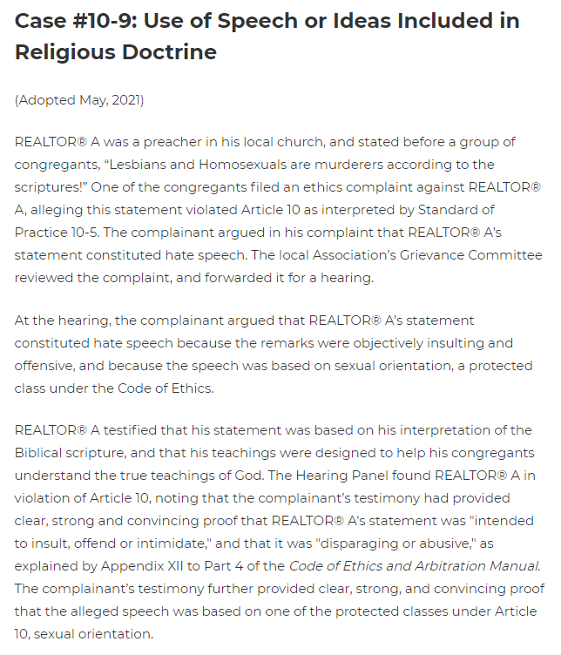
New Case Interpretations for Article 10, Standard of Practice 10-5
https://www.nar.realtor/code-of-ethics-and-arbitration-manual/case-interpretations-related-to-article-10
Notes:
Professional Standard Committee added a number of case interpretations related to Article 10, Standard of Practice 10-5 to provide additional context and understanding in the application of this Standard of Practice. These are available on NAR’s website if you are interested in reading them and learning more about the application of Article 10, Standard of Practice 10-5.
They can be accessed via the website on the slide. I’ve included one of the several that were added as well.

Slide 7
Questions?

