Slide 1

Virginia REALTORS® Standard Forms Updates
July 1, 2021 Release

Slide 2
July 2021 Updates
Seven
Updated Forms
Two
Brand-New Forms
One
Removed Form
Notes:
[Instructor]: Effective July 1, 2021, the Virginia REALTORS® Standard Forms library will change. The Standard Forms subcommittee decided to update seven forms, including some of the most-used forms like the residential lease and the residential purchase contract. The committee also created two new forms, both dealing with septic inspections for residential transactions. Finally, as a result of a law change in the 2021 General Assembly, the committee removed the SCRA Waiver from the forms library.

Slide 3
Updated FOrms

Slide 4
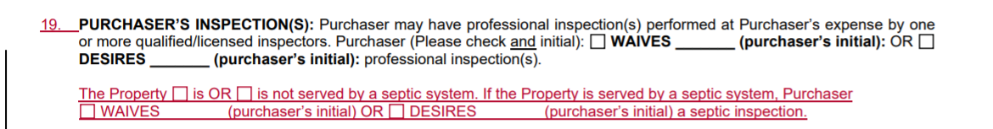
Form 600 – Residential purchase contract
Notes:
[Instructor]: The committee edited paragraph 19 of the purchase contract to provide a place for the seller to indicate whether a property is served by a septic system. The new language also allows the purchaser to indicate whether they want an inspection of the septic system. If so, the parties can use the new Septic Inspection Addendum that will be discussed later in this presentation.

Slide 5
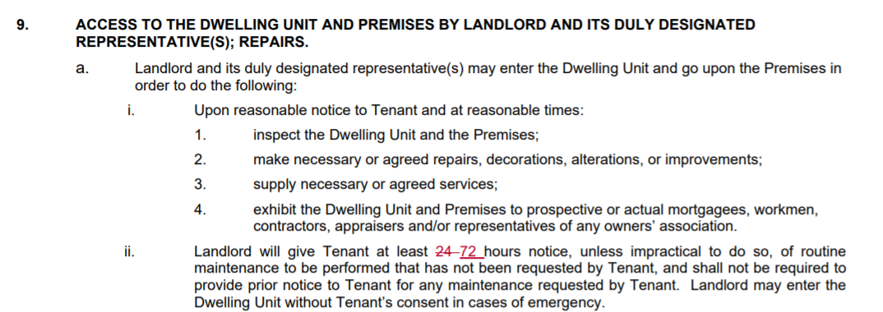
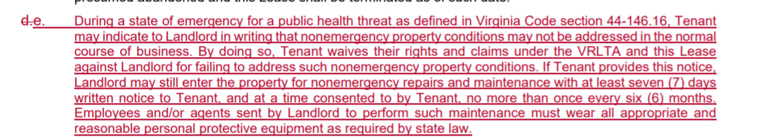
Form 200 – Residential Lease
Notes:
[Instructor]: The next form with changes is Form 200, the residential lease. Paragraph 9(a)(ii) was edited to reflect the law change that landlords must (as of July 1) give tenants 72-hours’ notice for routine maintenance, not 24 as was previously the case. The committee also added a new subparagraph to Paragraph 9. This reflects the law change as of July 1 that the Tenant may tell the landlord that they do not wish for the landlord to perform nonemergency maintenance on the property. If the landlord still wants to perform this maintenance, they must give the tenant at least 7 days’ written notice and wear all appropriate PPE.

Slide 6
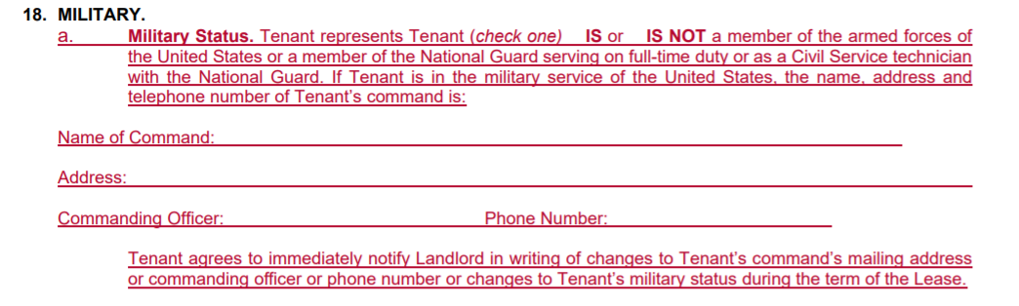
Form 200 – Residential Lease
Notes:
[Instructor]: Because of a change in the law regarding the SCRA waiver (which will be discussed more elsewhere in this presentation), the committee moved some information from our previous waiver form into the lease itself. The new subparagraph A under the Military section allows the tenant to state whether they are in the armed forces and, if so, to provide the name of command and contact info for the commanding officer.

Slide 7

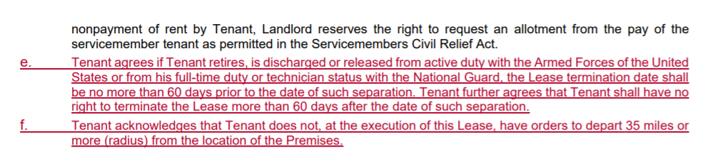
Form 200 – Residential Lease
Notes:
[Instructor]: Because the law will no longer allow for a preemptive waiver of rights under the SCRA, Paragraph 9(d) was edited to remove language regarding a waiver. The committee also added new subparagraphs e and f to provide acknowledgements that used to be contained in the SCRA Waiver form. By signing the lease, a tenant acknowledges that the lease termination date will be not more than 60 days before and not more than 60 days after the date of separation. The tenant also acknowledges that they don’t have pending transfer orders at the time of lease execution.

Slide 8
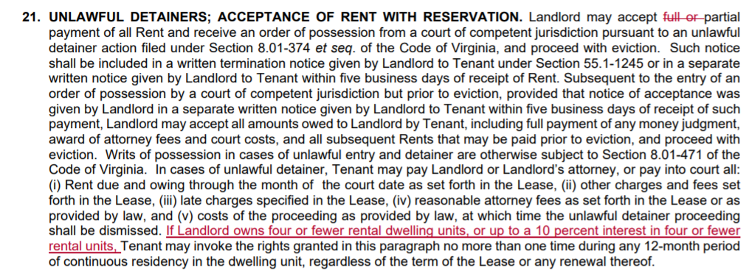
Form 200 – Residential Lease
Notes:
[Instructor]: Paragraph 21 was edited to reflect the law change that for landlords who own five or more properties in Virginia, tenants can use the right of redemption an unlimited number of times during a lease term. For landlords who own four or fewer properties, the tenant is still limited to only once in any 12-month period.

Slide 9
Form 200 – Residential Lease
Notes:
[Instructor]: Finally, the lease now makes clear that if a tenant’s noncompliance with the lease or the law leads to legal proceedings, the tenant is responsible for attorney fees for both the landlord and the property manager.

Slide 10
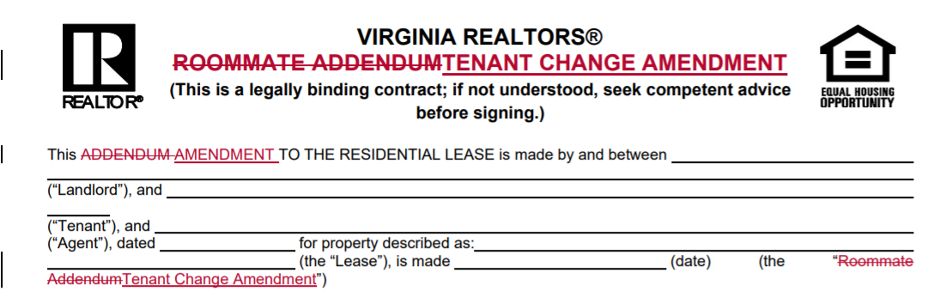
Form 250 – Tenant Change Amendment
Notes:
[Instructor]: Form 250 will change names, from the Roommate Addendum to the Tenant Change Amendment. This change is based on property managers telling the committee how they actually use the form in practice.

Slide 11
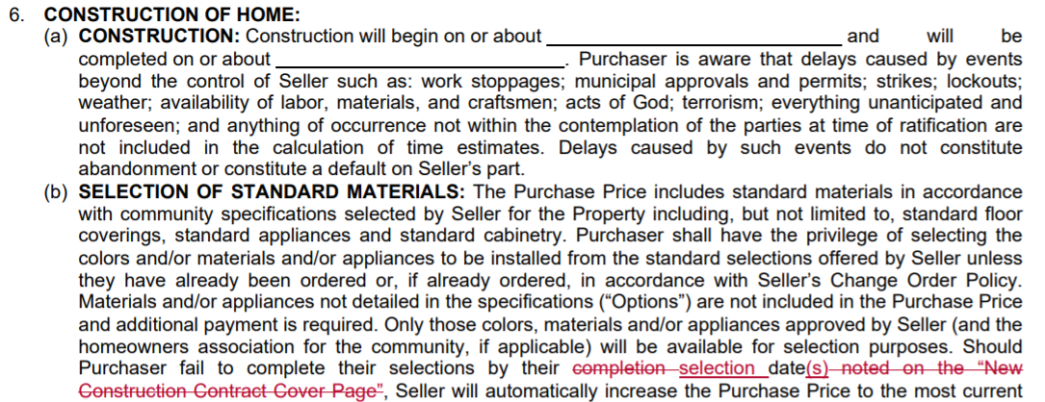
Form 670 – New Home COntract
Notes:
[Instructor]: Form 670 was edited to remove a reference to the Cover Page, which no longer exists on the form. Form 670 also now includes the choice-of-settlement-agent language as required by law.

Slide 12
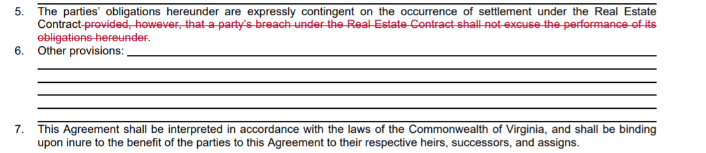
Form 1200 – Sale of personal property
Notes:
[Instructor]: This change to the sale of personal property form clarifies that if the purchase contract does not close for whatever reason, the sale of personal property agreement is no longer valid.

Slide 13
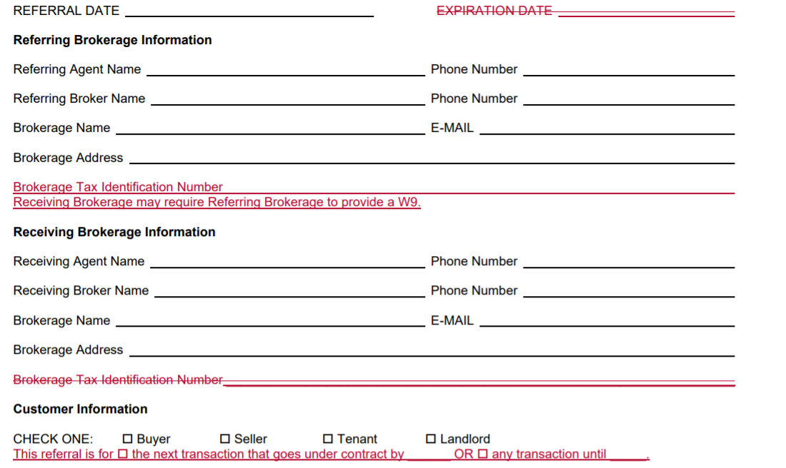
Form 800 Referral Agreement
Notes:
[Instructor]: The referral agreement was edited to request a TIN from the referring brokerage, not the receiving brokerage. It also now states that the receiving brokerage might require the referring brokerage to provide a W-9. The form also now has options for expiration. It can go until the next transaction that goes under contract by a certain date or it can cover any number of transactions that might occur by a given date. The form now states that the referral fee will be paid with 10 business days of whenever the receiving broker gets payment, not when the transaction settles.

Slide 14
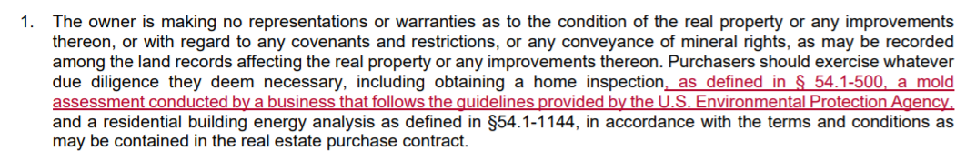
Form SUM-1 – Summary of Rights and Obligations
Notes:
[Instructor]: Finally, the SUM-1 form was updated to include language regarding a mold assessment due to a change in the law by the 2021 General Assembly.

Slide 15
New Forms
Notes:
[Instructor]: Both new forms deal with septic inspections. The complete forms will be available for you to view on our website at: https://virginiarealtors.org/law-ethics/legal/standard-forms/

Slide 16
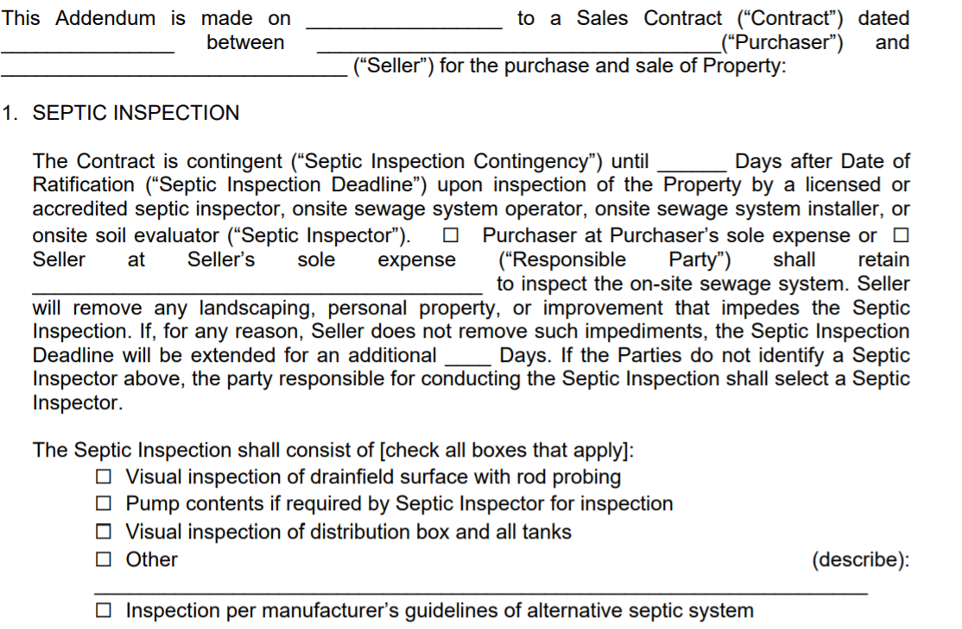
Form 600M – Septic Inspection Contingency Addendum
Notes:
[Inspector]: In September of 2020, the Standard Forms subcommittee decided to remove the septic inspection language from the body of the contract. In response to questions and suggestions from membership, the committee this year has decided to create a new septic inspection contingency addendum and accompanying removal form. The inspection addendum allows the parties to determine what kind of inspection will be done and at whose expense. It is modeled on the Virginia REALTORS® Home Inspection Addendum and provides a negotiation period and an ability for the purchaser to terminate. The addendum also includes language that will protect the parties and the brokerages from liability should the septic system be damaged as a result of an inspection done based on this document.

Slide 17
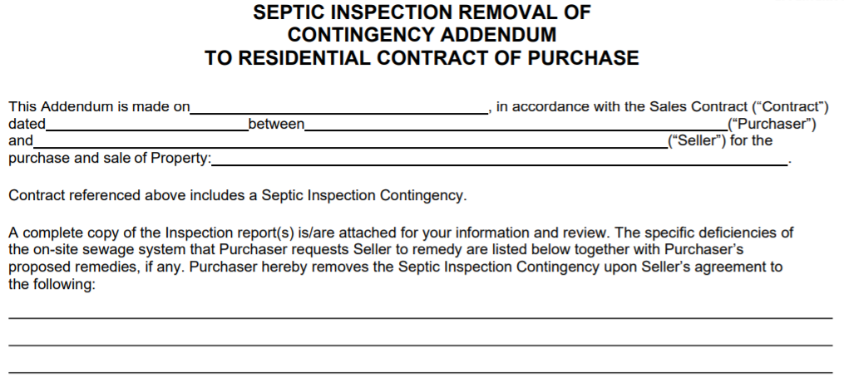
Form 600N – Septic Inspection Removal of Contingency
Notes:
[Instructor]: The final new form is this removal addendum for the septic inspection. It allows the parties do document what deficiencies (if any) the purchaser requests seller cure before the contract can move to settlement.

Slide 18
Removed Form

Slide 19
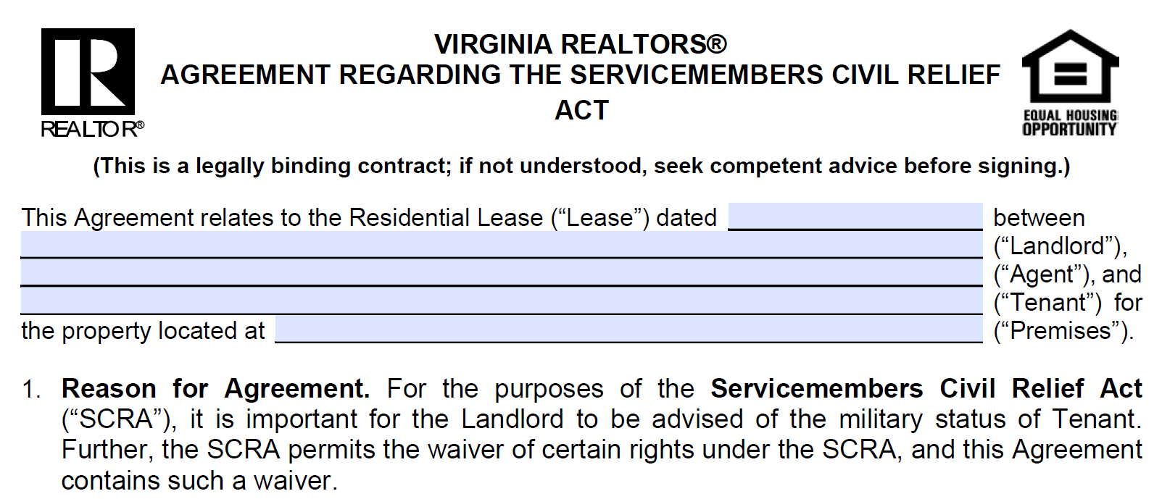
Form 280 – SCRA Waiver
Notes:
[Instructor]: Finally, the committee voted to remove Form 280 (the SCRA Waiver) from our library. The General Assembly passed a law this spring that made it illegal for a servicemember to waive his/her rights under the SCRA preemptively. As a result, the act of signing this form at the beginning of a lease term (as was the general practice for most landlords/PMs) is now outlawed. To protect our members, the committee decided to move some of the most important information that was in this form to the Lease itself and remove this form.

Slide 20
Questions?
Suggestions?
https://virginiarealtors.org/law-ethics/legal/standard-forms/
forms@virginiarealtors.org
https://virginiarealtors.org/legal-hotline/
Notes:
[Instructor]: If you have additional questions or want to see the documents yourself, you can go to our Standard Forms website link. We will have complete redline versions of these forms posted for you to view along with an explanation of what’s changed. If you have questions or suggestions for forms, you can either email us at forms@virginiarealtors.org or submit a ticket through the Legal Hotline.

