Slide 1

Virginia REALTORS PURCHASE CONRACT
Changes to Septic System Requirements

Slide 2

Overview
The Virginia General Assembly passed a law in 2020 requiring septic inspections done in conjunction with a real estate transaction to be performed by a licensed inspector.
01
This created issues with some traditional methods of “certifying” a septic system, like “walk-over” inspections. The Purchase Contract required the Seller to provide a certification.
02
Virginia REALTORS’ Standard Forms Subcommittee voted to make changes to its Residential Purchase Contract to accommodate.
03
Notes:
Instructor: Today we are going to discuss some changes Virginia REALTORS made to its form Purchase Contract regarding septic inspections, why they made those changes, and how to best represent your clients’ needs regarding septic inspections through contract.

Slide 3
Does the law require a septic inspection?
No! Neither state law nor regulations require a septic inspection be performed.
Who may require?
  A locality
  A lender
If not required by lender or locality, sales contract controls any such mandates or agreements to inspect.
Notes:
Instructor: It’s important to know first and foremost that nothing in Virginia state law or regulations requires a septic system to be inspected or pumped before a property is sold. A locality may require evidence that a septic tank has been pumped within the last five years. Some lenders may require a septic inspection before approving the loan. But if not required by the lender, any pumping, inspection, or other requirements will be controlled by the sales contract. Before this new law, the Virginia REALTORS® sales contract (Form 600) addressed septic system inspections in two places: paragraph 17 of the Contract and the Home Inspection Contingency Addendum (Form 600D).

Slide 4
New Law:
Be it enacted by the General Assembly of Virginia:
1. That §§ 59.1-310.9 and 59.1-310.10 of the Code of Virginia are amended and reenacted as follows:
§ 59.1-310.9. Requirements for accredited septic system inspectors and performance of septic system inspections.
A. In order to use the title of "accredited septic system inspector" in connection with any real estate transaction, including refinancings, an applicant shall be accredited by the National Sanitation Foundation or an equivalent national accrediting organization, which accreditation shall include the passage of both a written and practical examination on the principles and practice of septic system inspections.
In addition, the applicant shall satisfy the following requirements:
1. Hold a high school diploma or equivalent; and
2. Have evidence of at least one year of active field experience conducting onsite septic systems inspections or completion of a nationally approved training course.
B. Any individual who holds a valid onsite sewage system operator, onsite sewage system installer, or onsite soil evaluator license pursuant to Chapter 23 (§ 54.1-2300 et seq.) of Title 54.1 shall be authorized to perform a septic system inspection in connection with any real estate transaction, including refinancings.
§ 59.1-310.10. Penalty for violation.
No person shall use the title "accredited septic system inspector" or perform a septic system inspection in connection with any real estate transaction unless he meets the requirements of this chapter. Any person who violates the provisions of this chapter shall be is guilty of a Class 3 misdemeanor.
Notes:
Instructor: Before we dive into the contract changes, let’s take a look at the language of the new law. House Bill 1266 introduced the new language into the Code of Virginia regarding septic inspectors and inspections. The new language regarding real estate transactions is italicized and highlighted here.
[Click the links to the laws if you want to explore the language further]

Slide 5
Immediate Issues
(1) Concerns about the lack of inspectors that met the criteria were raised to the Virginia Department of Health
VDH responded with some resources, which did not provide much clarity in how to continue operations as normal
(2) Contract Requirements
Virginia REALTORS form Purchase Contract required the seller to provide the buyer with a certificate indicating no evidence of malfunction or needed maintenance
Contract language did not specify more than this, so many sellers accomplished this with a “walk over” inspection
After law passed, fewer licensed or accredited professionals were willing to provide such a certificate without a more extensive, and expensive, inspection
Notes:
Instructor: Real estate agents and brokers ran into several issues regarding this new law. The primary concern was a lack of inspectors that met the criteria required by the law. A secondary issue related to that was how form contracts handle septic inspections. Before September 2020, the Virginia REALTORS form Purchase Contract required the seller to provide the buyer with a “certificate” dated not more than 30 days before settlement indicating there was no evidence of malfunction of or needed maintenance to the sewage system. The certificate was to be from the appropriate governmental authority – the Virginia Department of Health or a local health department – or an acceptable private company. However, the paragraph did not go into detail on what must be done to determine whether there was evidence of malfunction or needed maintenance, and as a result many sellers had a simple “walk over inspection” where an inspector from a private company, maybe not even a septic company, looked for surface effluent. Virginia REALTORS began to hear that there were few licensed or accredited professionals who were willing to provide a certificate of any type without first conducting an inspection involving more than a “walkover,” and the cost of these more extensive inspections is significantly higher than buyers and sellers, or their agents, had anticipated. Further, the Home Inspection Contingency addendum requires any inspections, including septic, to be done by someone with the proper credentials and the law change made the required credentials that a septic inspector be licensed very clear.

Slide 6
Solutions
Virginia REALTORS’ Standard Forms Subcommittee made changes to several forms, including:
  Removing from the Purchase Contract the requirement that a Seller provide the Purchaser with a certificate stating that the septic system is in good working order.
  Removing references to “home” inspections throughout the Purchase Contract to make it clear that the inspection contingency is much broader than just a home inspection and allows for a number of other inspections, including septic systems.
  Adding language to the Standard Clause booklet for those who want to have a separate septic inspection contingency, distinct from the home inspection contingency.
Notes:
Instructor: Virginia REALTORS made some changes to its form offerings to accommodate the concerns resulting from the new law. First, it removed the requirement in the Purchase Contract that the Seller provide the Purchaser with a certificate stating the septic system is in good working order. For those agents and/or clients who want to require this, there is language in the Standard Clause booklet to accommodate this. The Virginia REALTORS Standard Forms subcommittee also decided to remove reference to a “home inspection” throughout the Purchase Contract to make it clear that the inspection contingency is more broad than just an interior home inspection and may include a number of other inspections, such as septic. The Home Inspection Contingency Addendum remains unchanged in this regard but please keep in mind that if your client chooses to get a septic inspection under that contingency, it must be done by a professional.

Slide 7
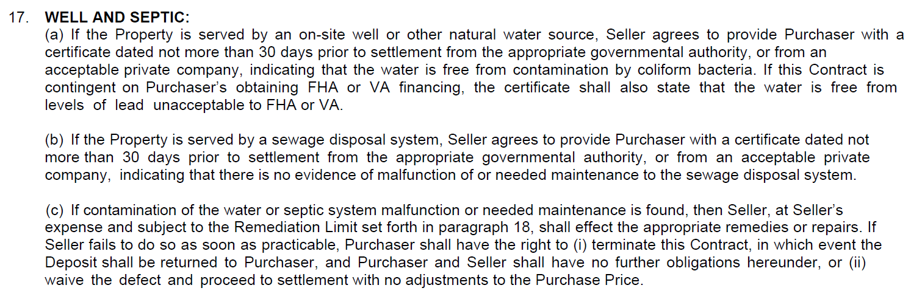
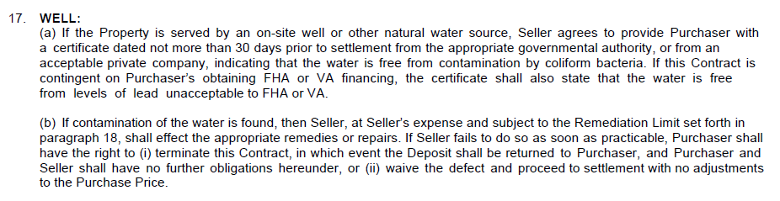
Purchase Contract Changes
Before 9/1/2020
After 9/1/2020
Notes:
Instructor: Here we can see the changes made to Section 17, including changing the heading from “Well and Septic” to just “Well.” The original Section (b) has been removed, which is the section that required a certificate, and references to septic in Section (c). Remember, there is no state law or regulation requiring a septic inspection be done before a property may be transferred.

Slide 8
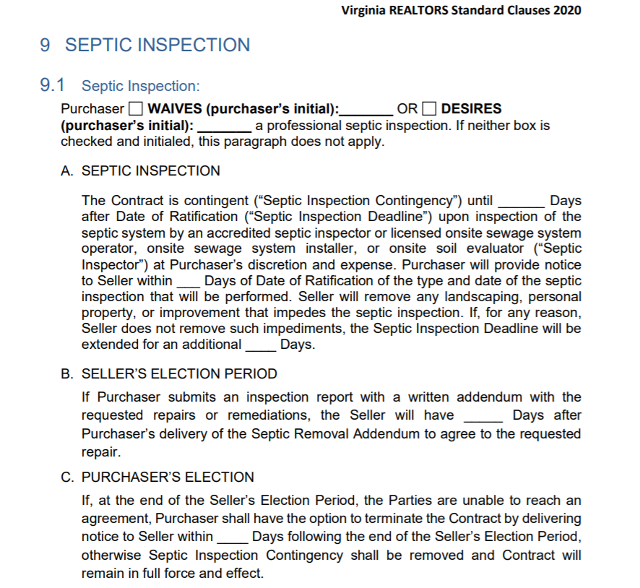
Septic Inspection Language
Notes:
Instructor: If you need to add language regarding a septic inspection back into a Purchase Contract, you can find that in the Standard Clause booklet that Virginia REALTORS provides. It is Form SCB 2020 [check that this form number has not changed as of the date of your presentation]. You will find the septic language in Section 9 of this booklet. You will note that the language requires the Purchaser to pay for such an inspection – so this shifts the burden of what used to be the Seller providing a certificate, to the Buyer now paying for an inspection. However, it also gives the Buyer a way to terminate the contract if repair or remediation of the septic system is required and the parties cannot come to an agreement on repairs.

Slide 9
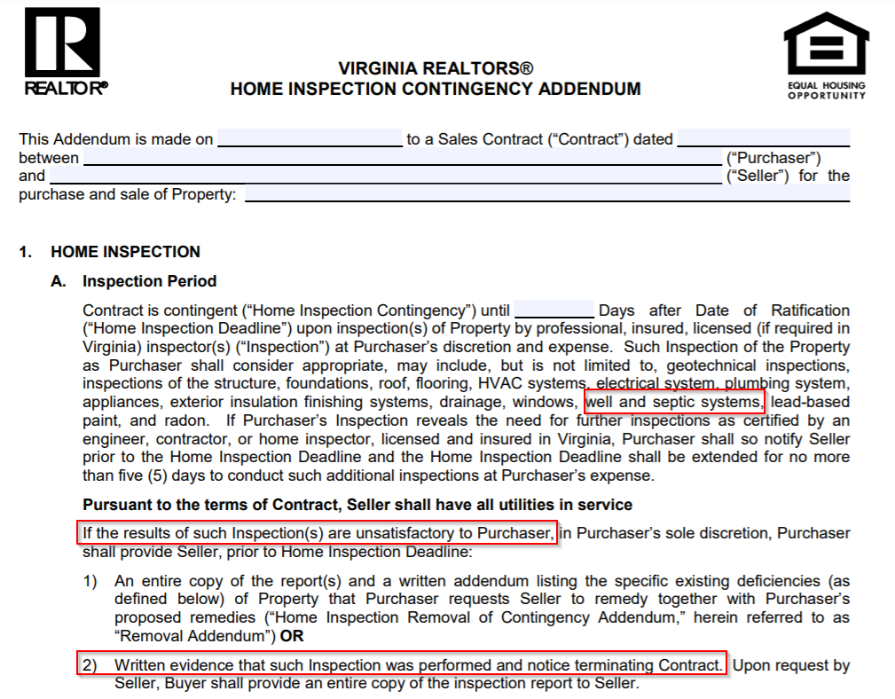
Home Inspection Contingency addendum
Notes:
Instructor: Further, the Home Inspection Contingency Addendum remains unchanged in this regard and can be used to pursue a septic inspection. This contingency also puts the burden on the Buyer to pay for the inspection, but also allows the Buyer to terminate the contract if the Buyer finds the results of their inspection(s) unsatisfactory.

Slide 10
Q&A
Q: Can the parties still agree to a cheaper walkover inspection?
A: Nothing in the law prohibits a walkover inspection. However, any septic inspection must be done by a licensed onsite sewage system operator, onsite sewage system installer, or onsite soil evaluator - and you may have difficulty finding such an inspector who will do just a walkover. Try to determine whether there is such an inspector before you recommend this course of action to your client.

Slide 11
Resources
Virginia REALTORS Septic Tank Inspection Resources: https://virginiarealtors.org/septic-tank-inspection-resources/
Virginia Department of Health Septic System and Private Well Service Providers: https://www.vdh.virginia.gov/environmental-health/onsite-sewage-water-services-updated/septic-system-and-private-well-service-providers/
DPOR License Lookup: http://www.dpor.virginia.gov/LicenseLookup/
Notes:
Instructor: (1)Virginia REALTORS has a page on their website dedicated to this issue, which includes a few blog post articles and a podcast.
(2) When concerns about having enough inspectors were raised with the Virginia Department of Health, VDH staff shared this website. If you scroll down on the page, there is a link to a map where you can select the type of license that you are looking for, and it will display providers. On that map, you would need to select “Installer”, “OSE”, and “Operator.” VHD acknowledged that this is not a complete list of licensees, but it is one resource available.
(3) Additionally, you can search for the license types in DPOR’s license lookup using the “Advanced License Search” feature under the “Board for WWWOOSSP” (Waterworks and Wastewater Works Operators and Onsite Sewage System Professionals). But this system isn’t great if you don’t know what you’re looking for or put in the right locality, and you may not get many results.
Finally, if an individual is “accredited” by the National Sanitation Foundation (NSF) or an equivalent national accrediting organization, for which accreditation includes the passage of both a written and practical exam, they are able to perform septic inspections. At this time there is no one location to search for accredited septic inspectors. This means you should ask the individual that your clients are working with whether they have been accredited by the NSF or equivalent national accrediting organization.

